Slide 1


“Retail is no longer local, it’s a global battlefield”
BY . EGBE GRACE

Slide 2



AGENDA
TABLE OF CONTENT
Introduction
01
Insights
05
Project Overview
02
Real -World Application and Impact
06
Data Wrangling
03
Challenges and Learning
07
Data Analysis and Visualisation
04
Conclusion
08

Slide 3



The Global SuperStore Analysis
Global Superstore is a large multinational retail company that sells a wide range of products, including furniture, office supplies, and technology, to customers across different regions worldwide.
BUSINESS PROBLEM
The dataset contains valuable information, but without proper analysis, it’s difficult to identify key performance drivers and opportunities for growth.
OBJECTIVES
# Identify top and low-performing regions, products, and segments
# Measure the impact of discounts and shipping modes
# Detect seasonal trends in sales and profitability
Provide clear, actionable recommendations

Slide 4


TOP 6 GLOBAL SUPERSTORE BUSINESS QUESTIONS
Sales & Profit by Region and Country
Profitability by Product Category
Customer Segment Performance
Which regions and countries generate the highest and lowest sales and profit?
What are the most and least profitable product categories and sub-categories?
How do different customer segments perform in terms of sales and profit?
Discount Impact
Shipping Mode Analysis
Seasonal & Monthly Trends
What is the impact of discounts on profit margins?
Which shipping modes are most used, and do they affect delivery time or order volume?
Are there seasonal or monthly trends in order volume and profitability?

Slide 5
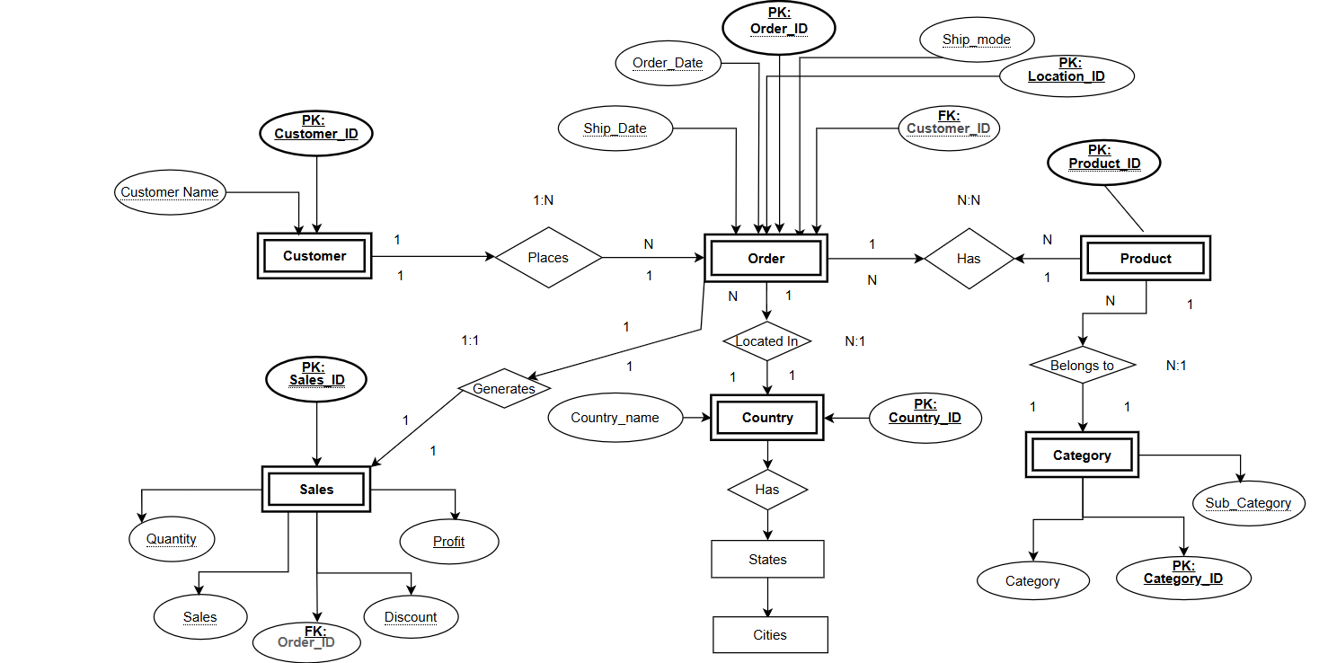
The Global SuperStore ERM
The Entity Relationship Model (ERM) was created to identify Key Entities, Attributes and their Relationship providing a clear view of the data structure for SQL Design and Analysis

Slide 6
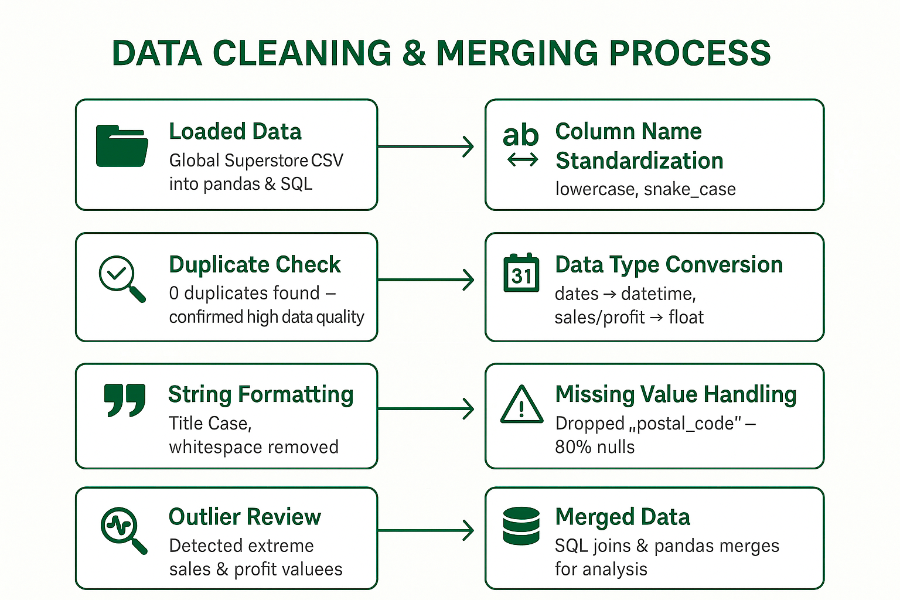

Data Cleaning & Merging Process
SQL-to-Power BI connection for seamless analysis

Slide 7
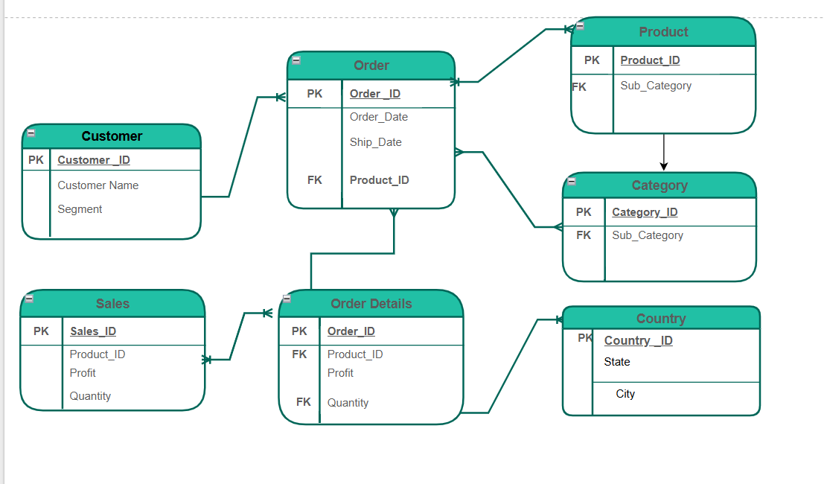
The Global SuperStore ERD
After finalizing the Cleaning, the Entity Relationship Diagram (ERD) was developed to define the database schema and table structures. Primary Keys (PKs) and Foreign Keys (FKs) were assigned to ensure data integrity and establish relationships between tables.

Slide 8
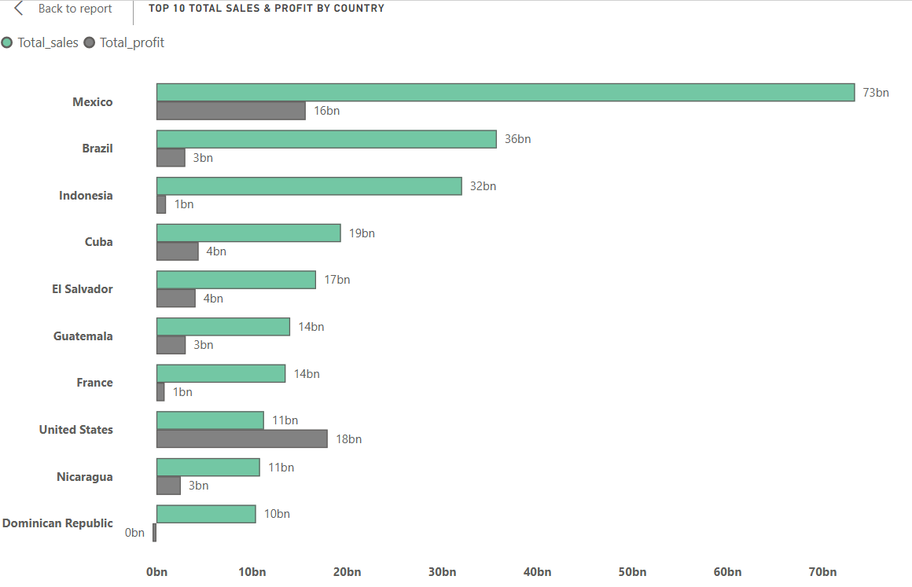
Exploratory Data Analysis (EDA)
Top 10 Total Sales & Profit by Country
Business Question:
Which countries generate the highest sales and profit?
Mexico leads with 73bn sales and 16bn profit.
Brazil and Indonesia follow in sales but with lower profits.
The United States shows relatively lower sales but higher profit margins.
Some countries (e.g., Dominican Republic) have minimal profits despite notable sales.

Slide 9
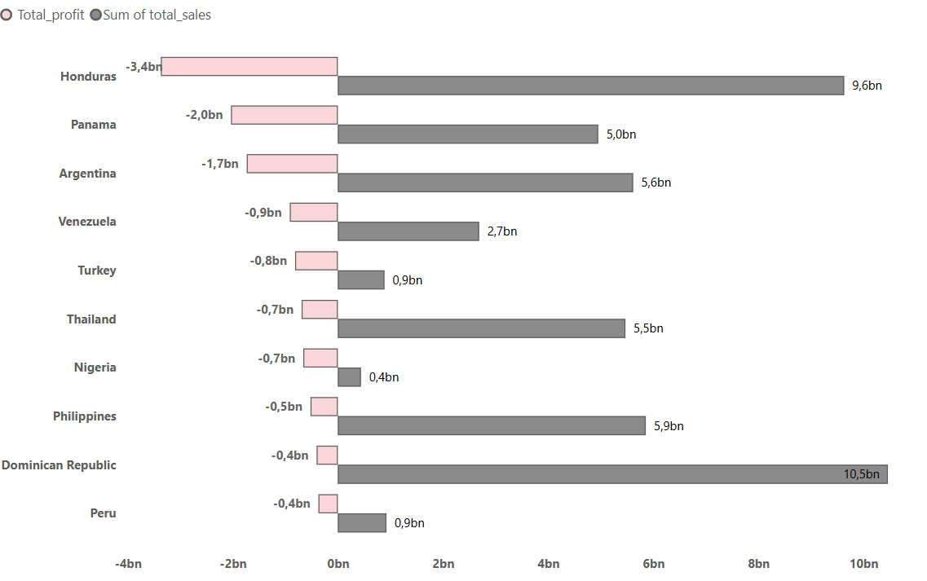
Bottom 10 Total Sales & Profit by Country
Business Question:
Which countries generate the Lowest sales and profit?
Bottom 10 Countries: Honduras, Panama, and Argentina show significant negative profits despite sales

Slide 10



Segment Performance Comparison – Profitability & Sales
Segments
Total Sales
Total Profits
Avg.Discount%
Avg.Profit Margin%
Consumer
$17.11bn
$2.35bn
4.52%
13.71%
Customer Satisfaction
$1.57bn
$4.01%
$16.87%
$9.29bn
Corporate
Home Office
$5.56bn
$0.66bn
4.53
11.91%
Business Question:
How do different customer segments perform in terms of sales and profit?
Consumer drives the highest sales, but Customer Satisfaction leads in profit margin, while Home Office remains the weakest segment.

Slide 11
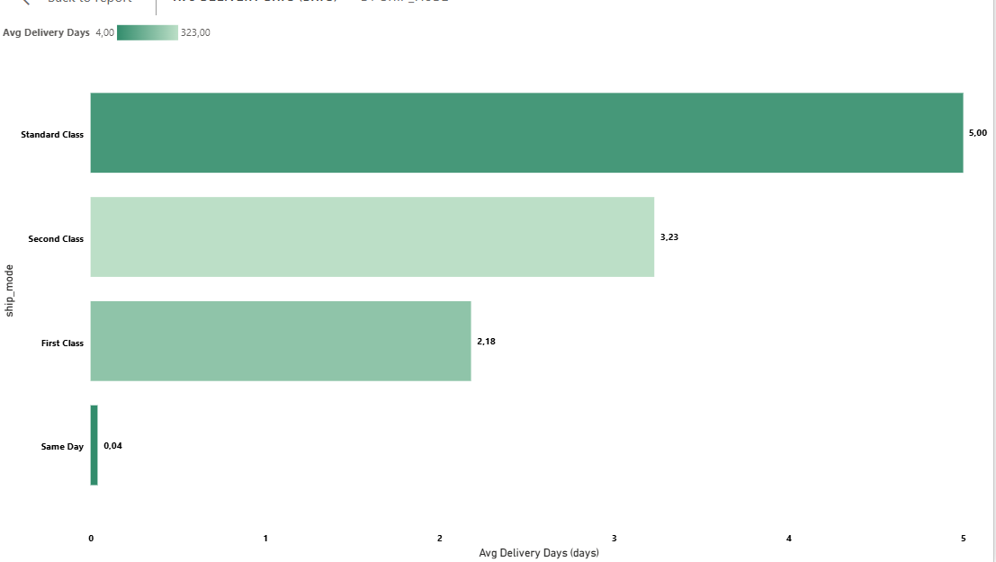
Average Delivery Days by Shipping Mode
Business Question:
"How does the choice of shipping mode impact delivery time?"
Standard Class takes the longest (5 days), while Same Day delivers nearly instantly (0.04 days), highlighting major speed differences across shipping modes

Slide 12
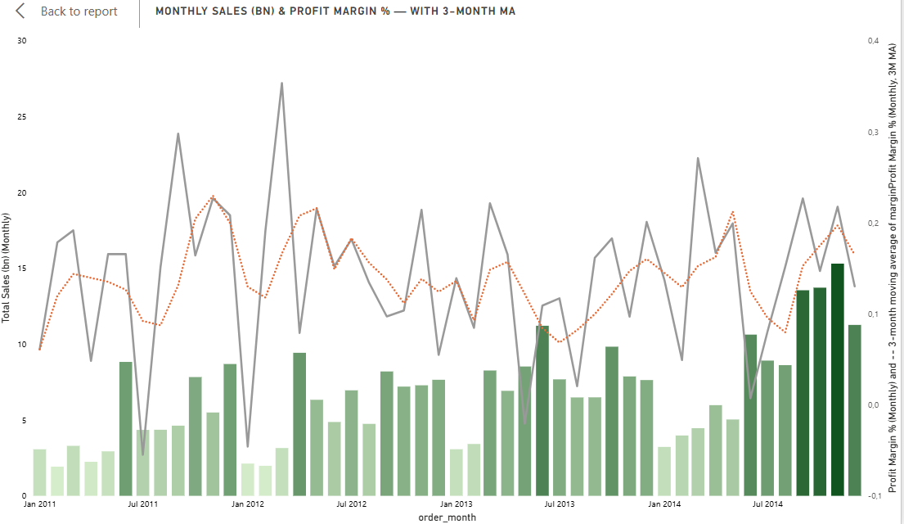
Monthly Sales (Bn) & Profit Margin % — with 3-Month Moving Average

Slide 13
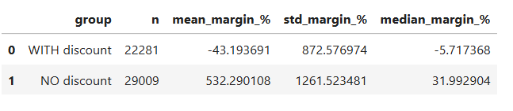


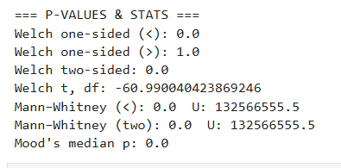


Hypothesis Test
Impact of Discounts on Profit Margin
Compared profit margins for orders with vs without discounts.
Applied multiple statistical tests at α = 0.05 (Welch, Mann–Whitney, Mood’s median).
Statistical Test Results (α=0.05)
Most tests had p-value < 0.05 → reject H₀.
Strong evidence discounts reduce profit margins.

Slide 14


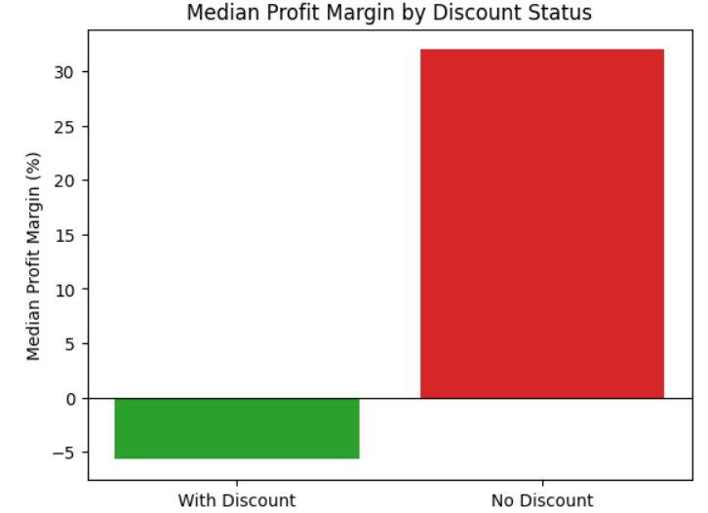
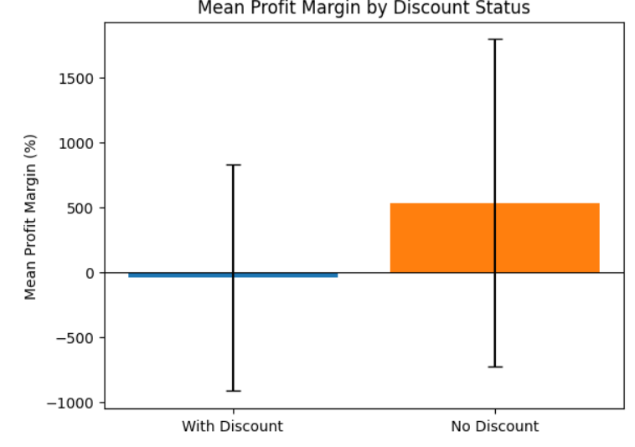
Effect Size Analysis: Discounts vs. No Discounts
75% CI confirms the drop is statistically significant and substantial.
Mean difference (with − no): -575.48%
95% CI (Welch): [-593.98%, -556.99%]
Hedges’ g: -0.531 (large negative)
Cliff’s delta: -0.590 (large negative

Slide 15
Key Business Insights
# Orders with discounts have a 575% lower profit margin compared to non-discounted orders.
# Large negative effect sizes (Hedges’ g: -0.531, Cliff’s delta: -0.590) indicate a strong negative impact of discounts on profitability.
# Statistical tests (at 5% significance level) confirm this difference is not due to chance.
# High regional variability in profitability — East & West at 100% margin, Africa & EMEA unprofitable
# Discounts significantly reduce profit margins (large negative effect confirmed by hypothesis test)
# Standard Class dominates order volume; long delivery delays in Second Class impact efficiency
Recommendations
# Reassess discount strategy to focus only on strategic or seasonal promotions.
# Use targeted discounts for high-value or low-risk products to maintain profit margins
# Monitor post-discount sales vs. profit to evaluate promotion effectiveness

Slide 16
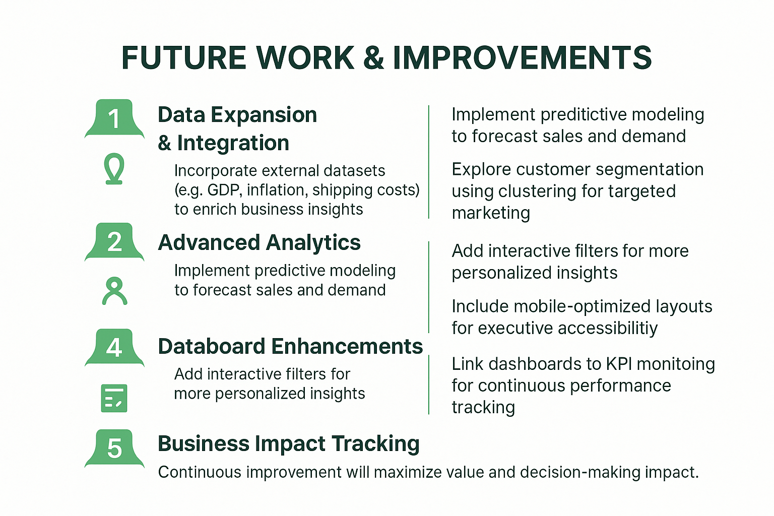
Future Work & Improvement

Slide 17


Resources & Tools
Python
SQL (MySQL / SQLite)
Power BI
Excel
Draw.io
Canvas
Trello
Online Documentation & Tutorials – Python, SQL, and Power BI references.

Slide 18
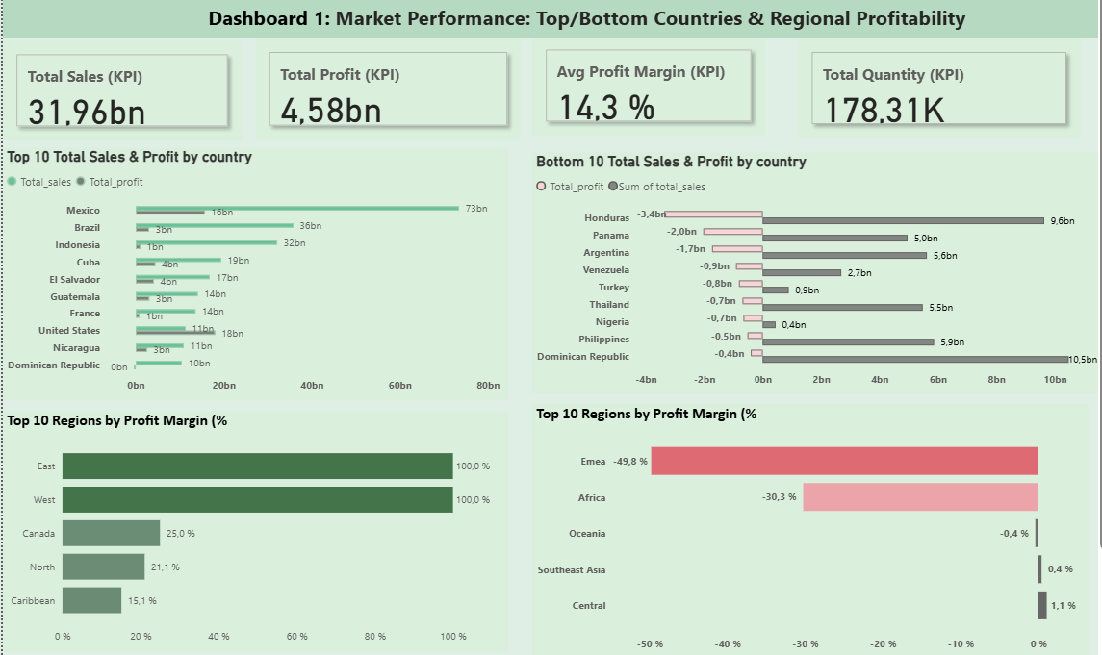

Slide 19
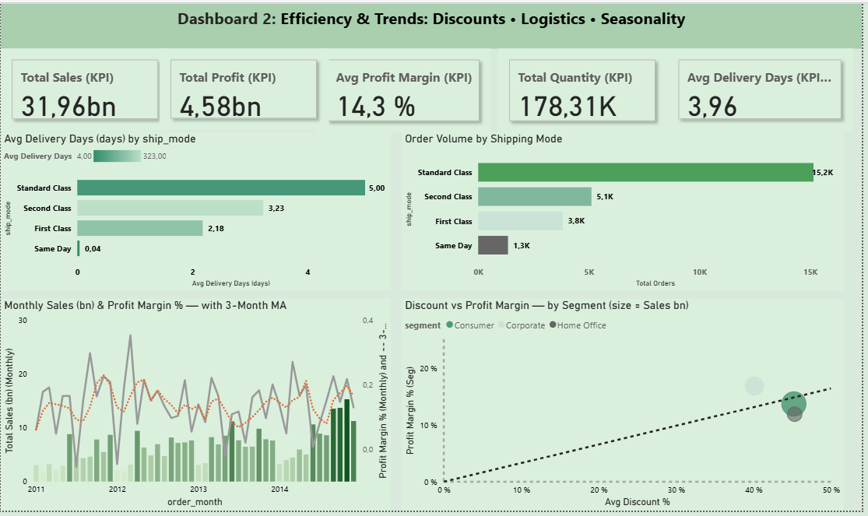

Slide 20
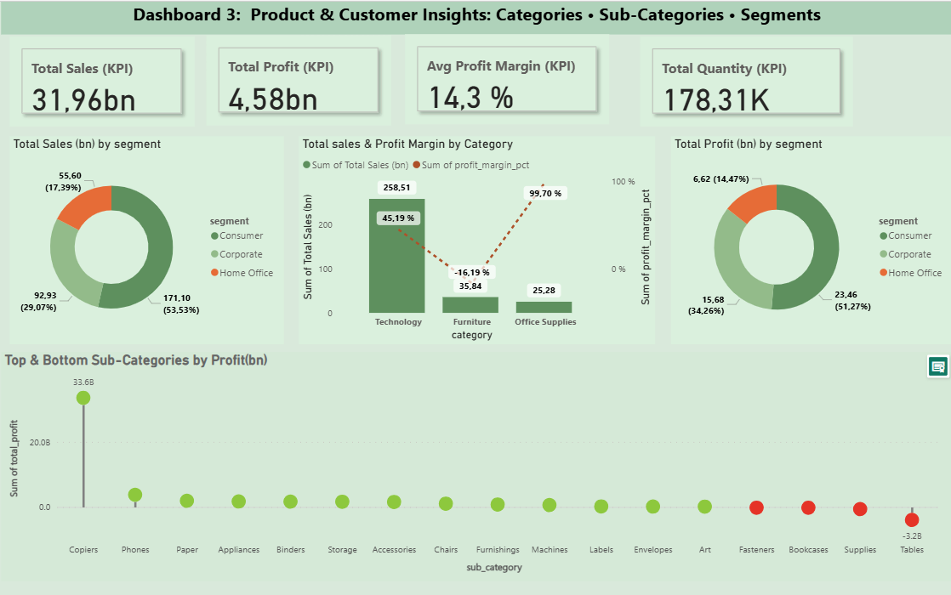

Slide 21


